Slide 1

HELLO!
Arid and Semi Arid Decision Platform.
You can find me at
@kevmwega

Slide 2
Arid and Semi Arid Lands Decision Platform.
Cloud based ASAL Decision Platform based on Data collected from remote water points.

Slide 3
“Water Scarcity is either the lack of enough water (Quantity) or lack of access to safe water (Quality).”

Slide 4
ASAL Decision Platform Functionality.
Demo Functionality.
Manage County and Country level accounts.
Monitor water points status, historical data and provided analytics.
Provide APIs to get distance to water points and weather conditions.
Improvements.
Provide users with Alerts and notifications on water points.
Provide USSD interface for citizens.
Provide platform for device management and admin.
Provide chatbot across multiple platforms.

Slide 5
ASAL Decision Platform Technical
Demo Features
Nodejs API Server.
Spring boot Application.
Thymeleaf.
AWS EC2 instance.
IBM Cloudant Database.
Docker
Improvements
Application unit testing.
Logs/Stats Aggregation.
CI/CD pipeline.(Circle Ci)
Kubernetes/Terraform.
Deploy services independently.
Failure isolation (timeouts, bulkheads, circuit breakers (Hystrix)).
Implement a load balancer. (Zuul)
Implement a service registry. (Eureka)

Slide 6
Technical Components.
Data Processing & Storage
Data Visualisation & Analytics
Spring Boot.
Nodejs API
Application Server (AWS EC2).
DataBase. (IBM Cloudant).
Docker
Spring Boot.
Thymeleaf.
Nodejs Swagger.

Slide 7
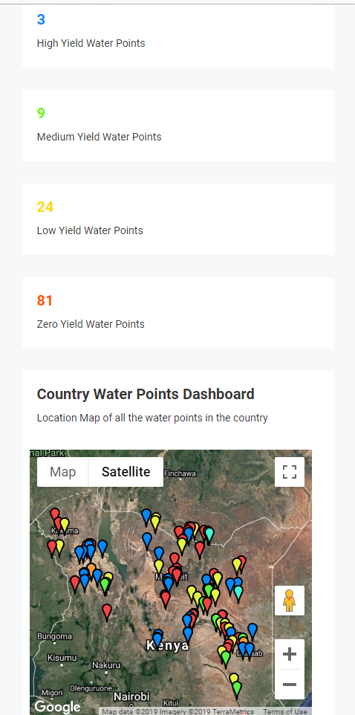
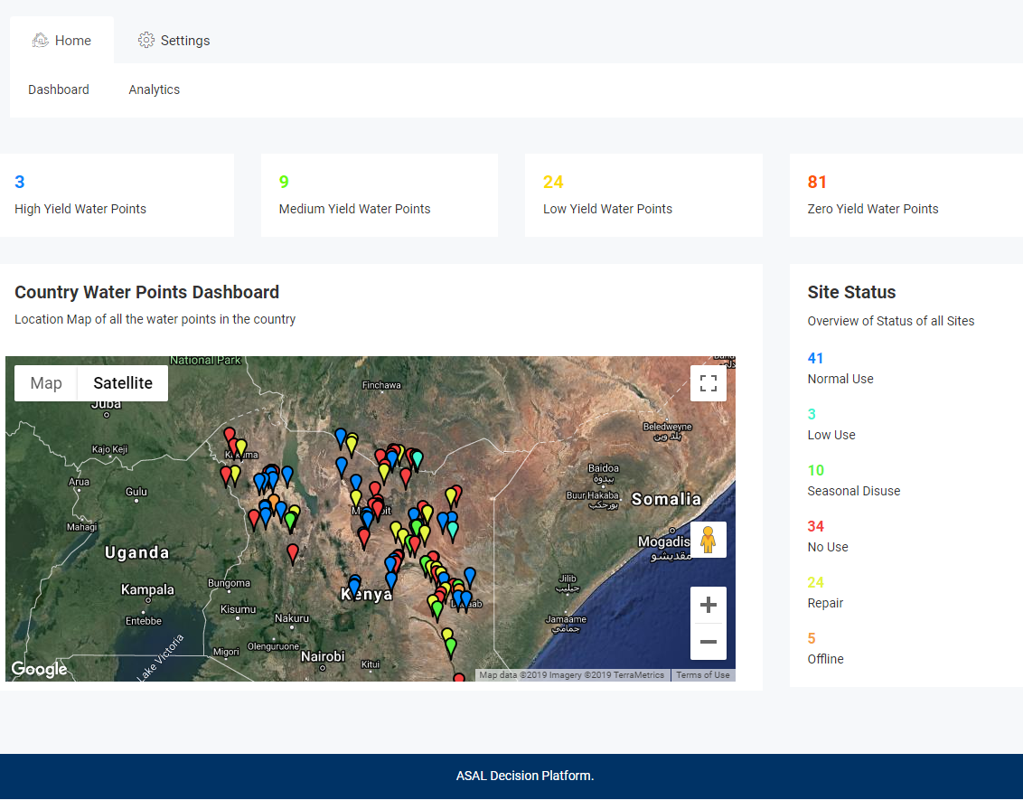
Ministry of water Officer.
Monitor all water points in country
View Historical Data on all water points.

Slide 8
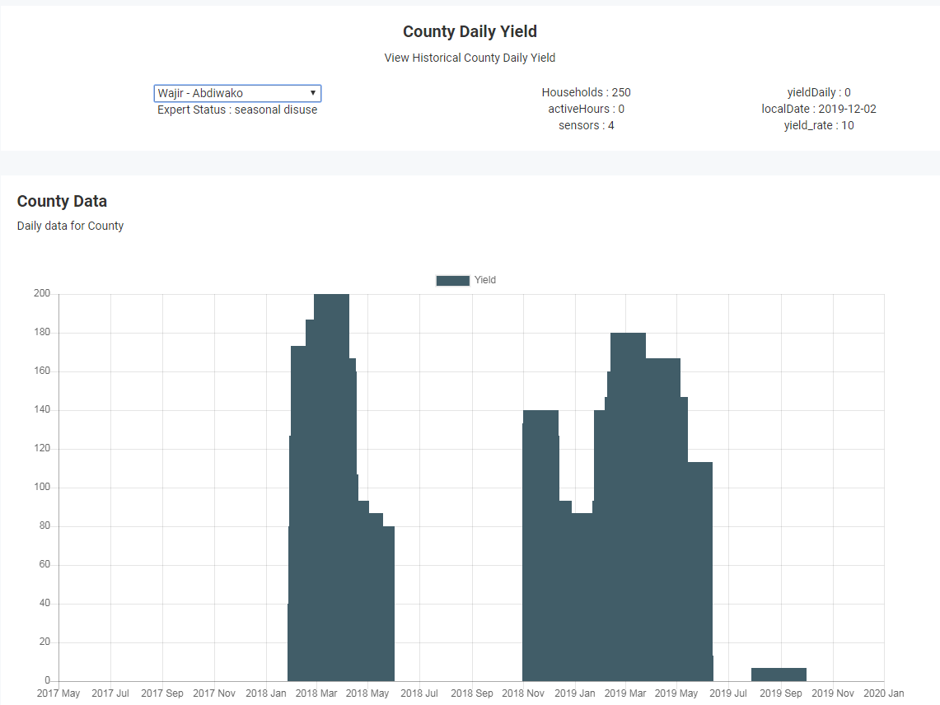
County Officer Portal.
Overview of all waterpoints
Historical Data of Waterpoints
Place your screenshot here

Slide 9

THANKS!
Any questions?

